Slide 1
Introduction
Purpose:
Address challenges in potato cultivation caused by climate change and emerging plant diseases.
Objective:
Ensure sustainable agricultural practices, optimize crop traits for resilience, and align interventions with Sustainable Development Goals (SDGs).

Slide 2
Key Components of the Ensemble Model
Transformer Models
Text Generation:
Utilizes fine-tuned auto-regressive transformer model (Llama-3.2-1B-Instruct).
Generates insights on potato varietal traits, genetic markers, and socio-economic dynamics.
Predicts optimal trait combinations for specific climate scenarios and disease prevalence.
Semantic Scoring:
Fine-tuned encoder-only transformer model (MPNet-based).
Classifies semantic alignment of outputs with SDGs.
Provides confidence scores for SDG alignment to track progress.

Slide 3
Epidemiological Modeling
Simulates disease dynamics by integrating:
Environmental triggers climate data (temperature, humidity, wind speed).
Soil pH and trade routes, means of transportation, packaging and seed handling.
Represents disease spread pathways through network models with:
Nodes: Regions with risk factors.
Edges: Connectivity via trade and distance.
Outputs: Risk vectors, matrices, and disease risk assessments.

Slide 5
Retrieval-Augmented Generation Systems (RAGs)
Incorporates real-time epidemiological data (updated daily via API).
Aligns climate and disease risks dynamically with AI-driven recommendations.

Slide 6
Markov Chain Models
Predicts future states of SDG targets.
Uses confidence scores from semantic scoring as inputs for continuous-time Markov chains.
Forecasts progress toward SDGs based on cropland connectivity.

Slide 7
Data Sources and Methodology
Data Sources:
Curated data on potato traits, genetic markers,
socio-economic dynamics, and climate.
Sources: CIP reports, Agricrops databases,
Wageningen University, openweatherData.org.
Model Fine-Tuning:
Potato-Wizard_v59 fine-tuned using
Low-Rank Adaptation (LoRA) for efficiency.
MPNet sentence transformer fine-tuned
on premise-hypothesis-label datasets
for semantic classification.

Slide 8
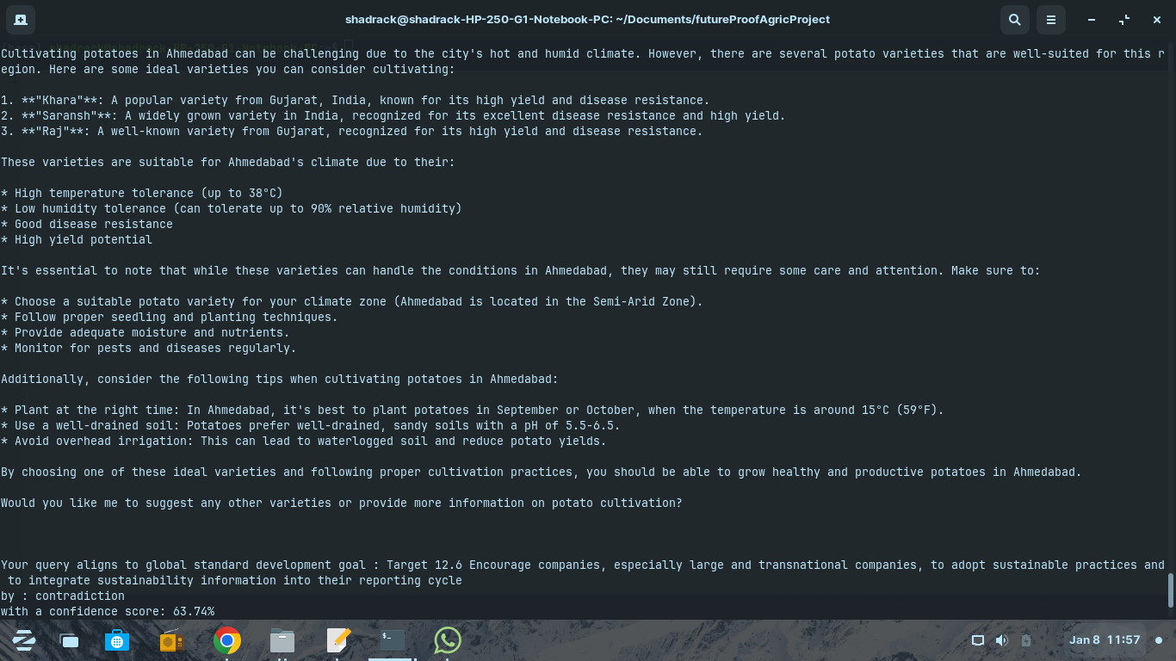
Output and Applications
Disease Risk Assessment:
Early warnings for outbreaks in potato-growing
regions of Kenya, Uganda, Peru, China, and India.
Varietal Recommendations:
Suggests resistant varieties optimized for
forecasted climatic conditions and disease risks.
SDG Alignment:
Tracks alignment with SDG 2 (Zero Hunger) and
SDG 13 (Climate Action) using semantic scoring
and Markov predictions.
Dynamic Risk Analysis:
Provides region-specific risk matrices for targeted
interventions and policy planning.

Slide 9
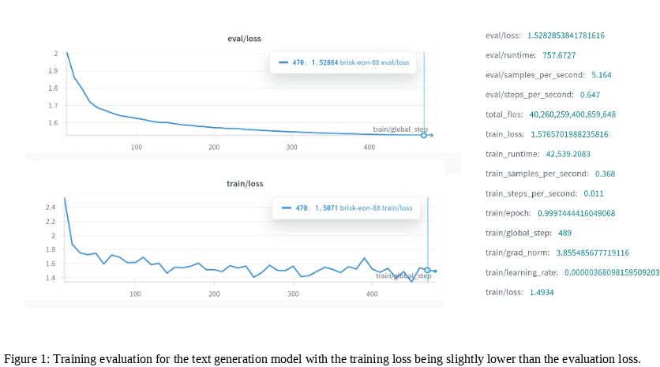
Results
Fine-tuned Potato_Wizard_v59:
Training loss: 1.49
Evaluation loss: 1.52
Operates in both offline mode for localized
insights and real-time alignment.
Facilitates actionable insights for farmers,
breeders, and policymakers.

